Slide 1


Lecture 1 – Introduction
COMPX310| Irfan Ahmad | AI | Data Science | Computer Science

Slide 2
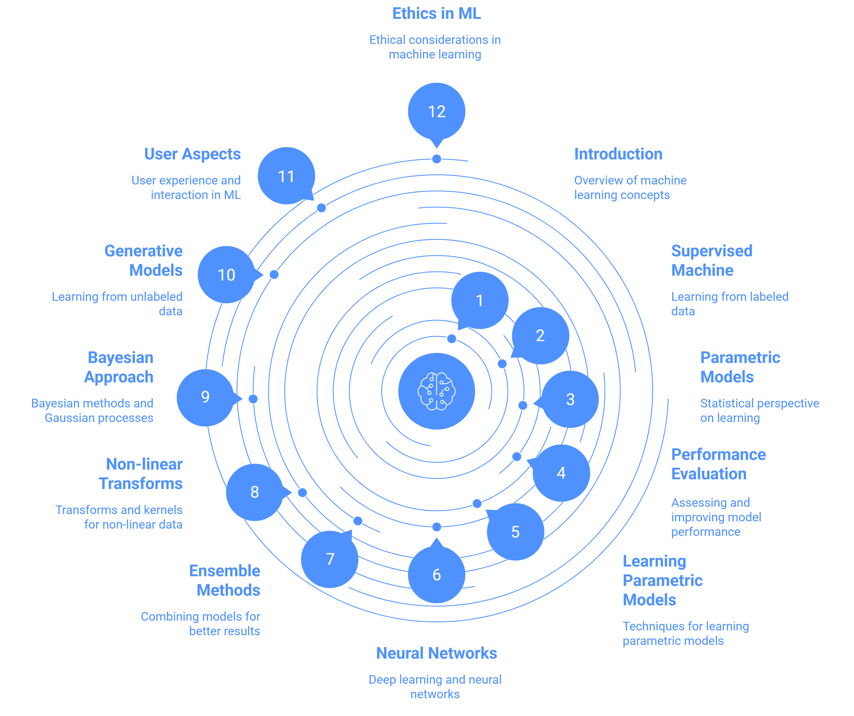
Topics
Notes:
4

Slide 3
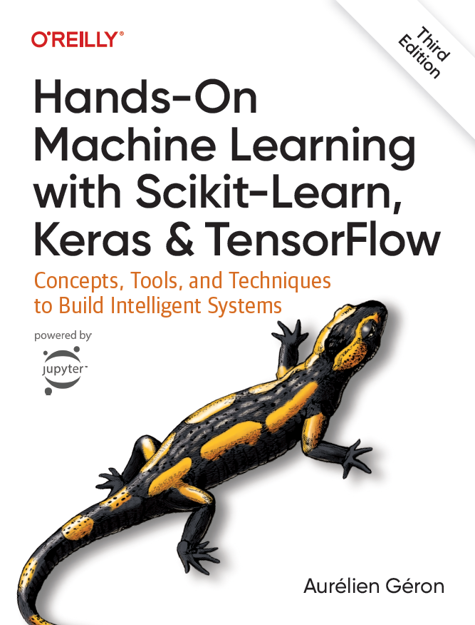

Recommended Book
Notes:
4

Slide 4

Assessment
Practical/Lab (9 sessions) - 36 marks
Quizzes x9 - 9 marks
Midterm - 15 marks
Final Exam - 40 marks
Notes:
4

Slide 5
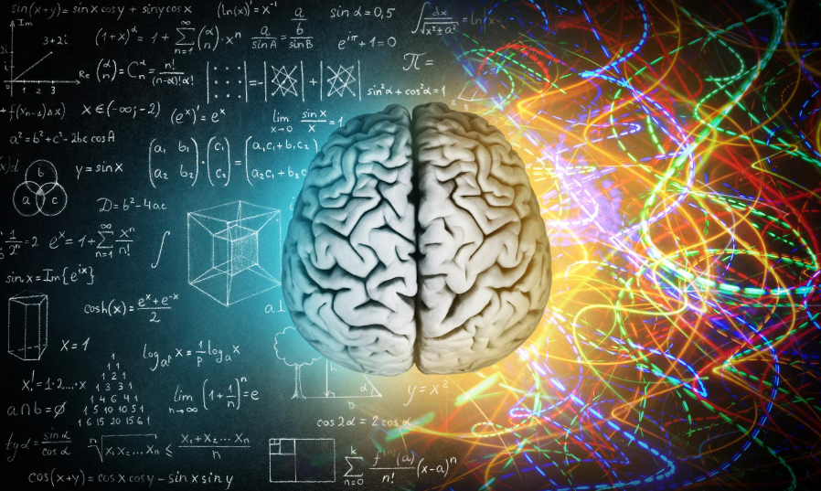
Background

Slide 6







Why Machine Learning Matters
Already powers billions of devices and daily tasks.
First popularized by OCR and spam filtering in 1990s.
Enables smarter apps: voice, translation, recommendations.
Notes:
4

Slide 7
Subsets Of AI
AI
Data Science
Machine Learning
Deep Learning
Notes:
4

Slide 8


What is Artificial Intelligence (AI)?
Human
Machine
Artificial Intelligence (AI)
Intelligence is the attribute of Humans
A way to make machines think and behave intelligently.
Mimic the human intelligence in machine
Notes:
4

Slide 9







What is Machine Learning?
Human Vs Machines
Human
51, 73, 39, 223, 43
Machine
31, 53, 89, 213, 83
15, 34, 97, 213, 34
Data
Rules
Notes:
4

Slide 10

What is Machine Learning?
Traditional Vs Machine Learning
Rules
Traditional Learning
Answers
Apple
Data
Answers
Machine Learning
Apple
Rules
Data
Notes:
4

Slide 11




Machine Learning - Definitions
Science of programming computers to learn from data.
Learns without explicit programming (Arthur Samuel, 1959).
A program learns task T, improves performance P on T, through experience E (Tom Mitchell, 1997).
Notes:
4

Slide 12


ML Example — Spam Filtering
Give spam (flagged by users) and regular emails as a training set to computer, where each email is a training example.
Here:
Task (T): Classify emails as spam or not.
Experience (E): Labeled emails used as training data.
Performance (P): Accuracy of correct spam predictions.
Notes:
4

Slide 13
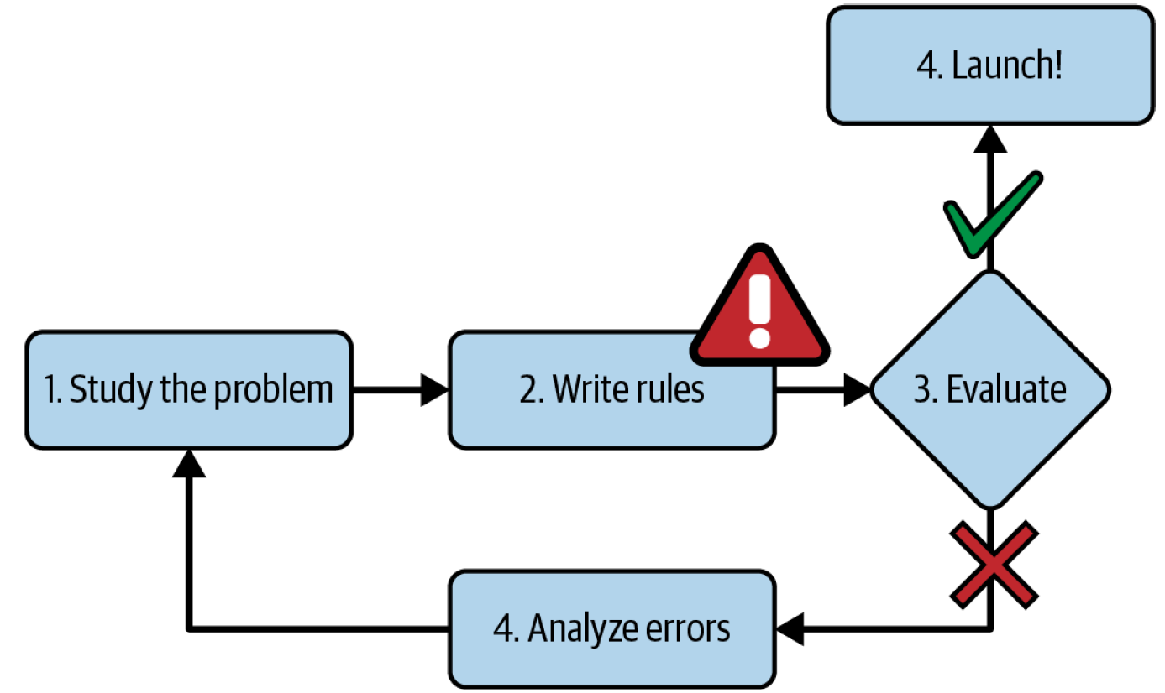
Building a Spam Classifier Manually
Three steps to build spam classifier using traditional approach:
Notes:
4

Slide 14
Building a Spam Classifier Manually
Step 1: Examine typical spam words, phrases, and email patterns (“such as “4U”, “credit card”, “free”, and “amazing”)
Notes:
4

Slide 15
Building a Spam Classifier Manually
Step 1: Examine typical spam words, phrases, and email patterns (“such as “4U”, “credit card”, “free”, and “amazing”)
Step 2: Write detection code to find suspicious email patterns.
Notes:
4

Slide 16
Building a Spam Classifier Manually
Step 1: Examine typical spam words, phrases, and email patterns (“such as “4U”, “credit card”, “free”, and “amazing”)
Step 2: Write detection code to find suspicious email patterns.
Step 3: Repeat Step 1 and Step 2 until satisfied.
Notes:
4

Slide 17
Building a Spam Classifier Manually
Since problem is hard: program becomes complex list of rules.
Hard to understand and hard to improve.
Notes:
4

Slide 18
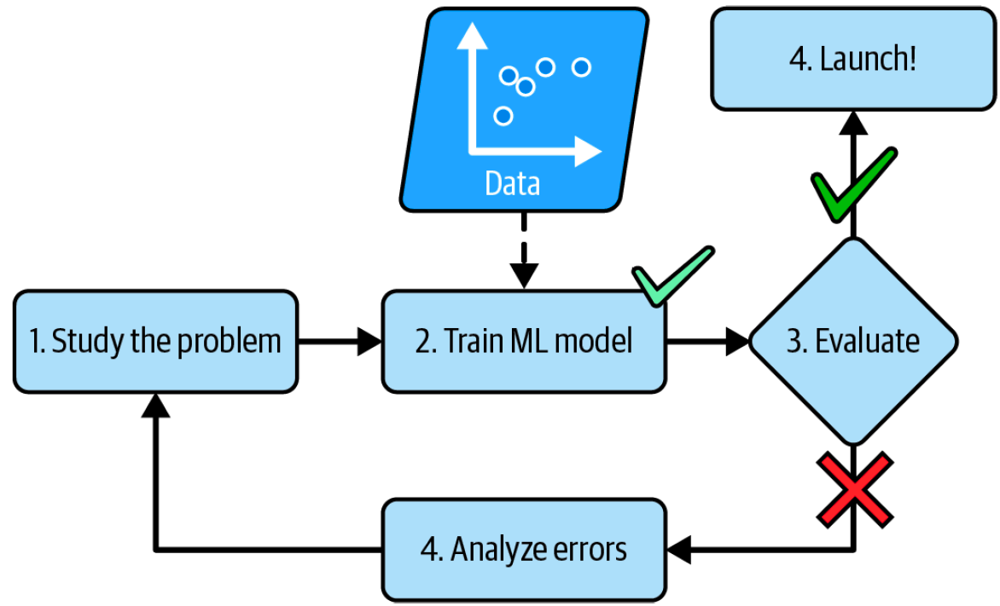
Spam Classifier Using Machine Learning
ML spam filter learns patterns automatically from data.
Learning algorithm detects frequent Spam words compared to Ham emails.
Program is shorter and easier to maintain.
Notes:
4

Slide 19
Machine Learning is Better Approach
Let's say, spammers replace “4U” with “For U” to bypass rules.
Traditional filters need new rules for each word change.
Notes:
4

Slide 20
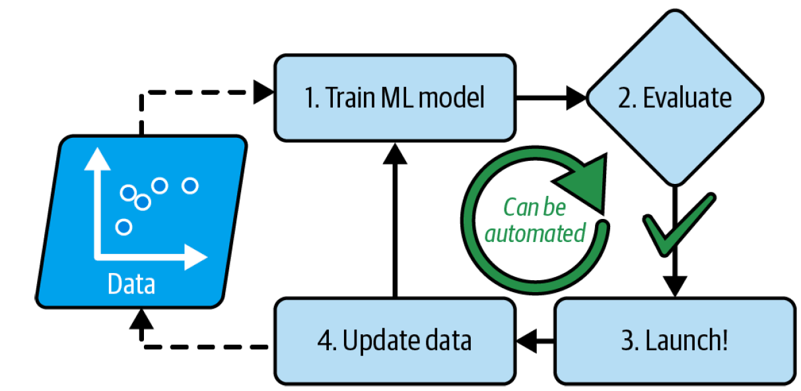
Machine Learning is Better Approach
ML detects new spam patterns like “For U” automatically.
Flags suspicious emails without human intervention.
Notes:
4

Slide 21
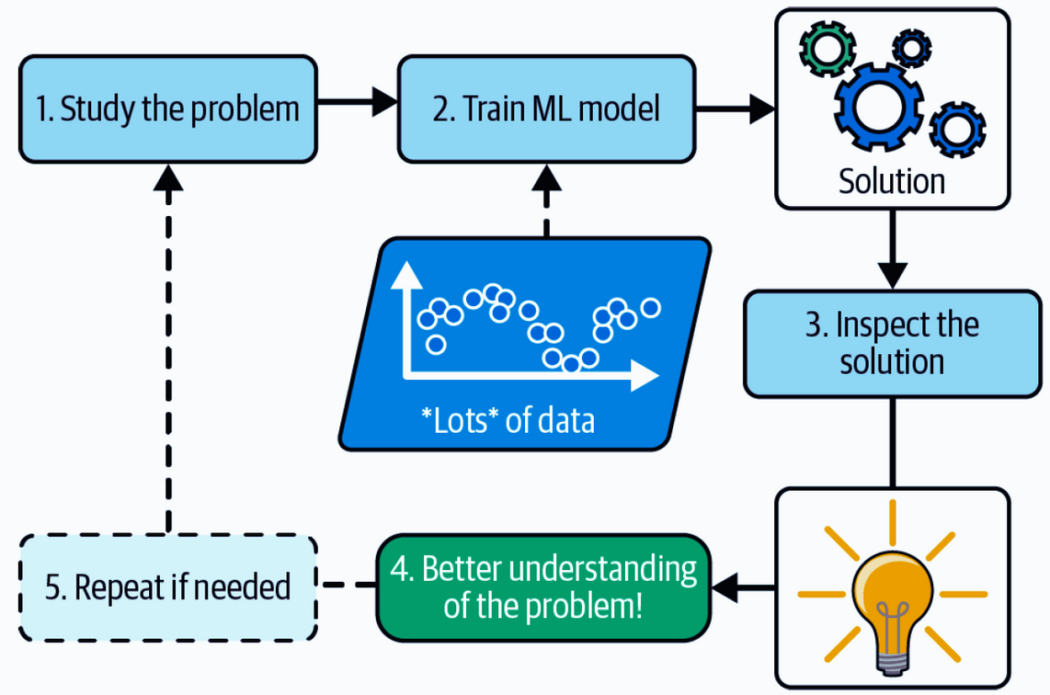
Machine Learning Help Humans Learn
Find patterns in large amounts of data (called Data Mining).
Helps humans better understand a problem, e.g., new spam features.
Notes:
4

Slide 22
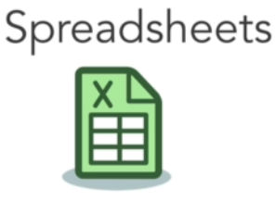
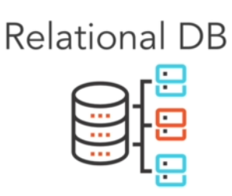
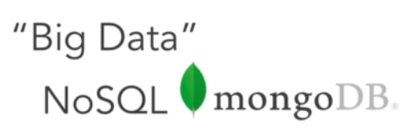

Why We Need ML Systems?
Notes:
4

Slide 23
Machine Learning is good for:
Problems that need long list of rules
Problems with no good traditional solution
Problems that change over time
Getting insights from large and complex problems / data
Notes:
4

Slide 24
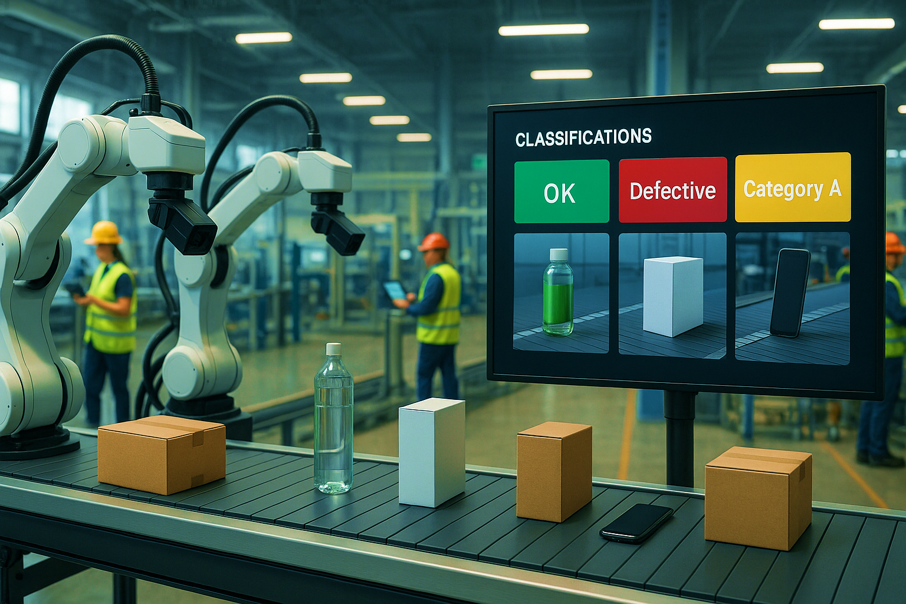
Examples of Applications
Analyzing images of products on a production line to automatically classify them.
Notes:
4

Slide 25
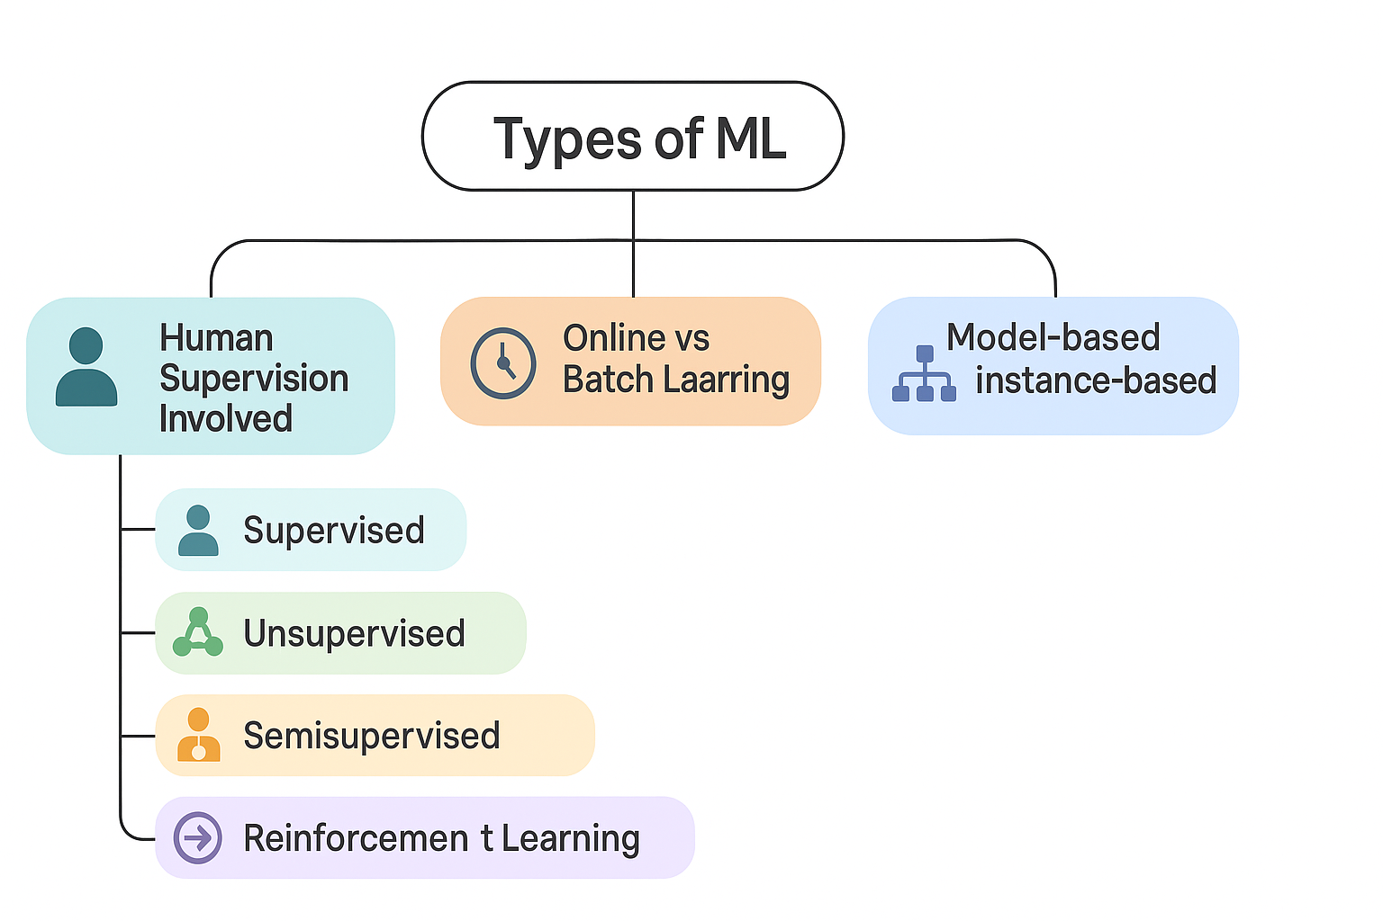
Types of ML
Notes:
4

Slide 26

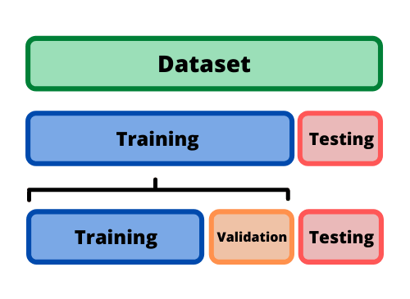
Terms to Remember
Training Data: data examples used to train the model.
Has features (like age=21) and a label/target (like spam or ham).
Features are also called predictors or attributes.
Often stored in CSV files (structured format).
Test Data: new data examples used to check model performance.
Has the same structure as training data.
Helps measure how well the model works.

Slide 27
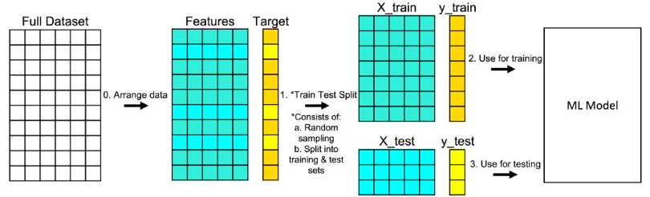
Terms to Remember
Training Data
Test Data

Slide 28

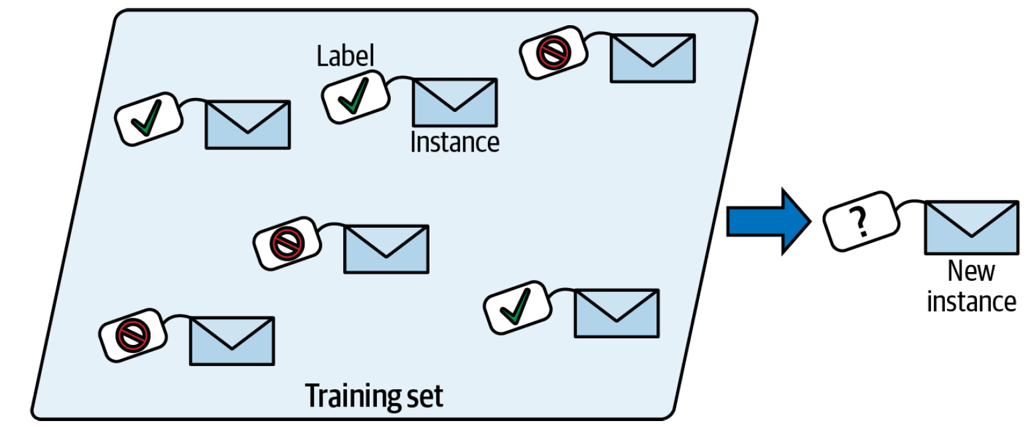
Supervised Learning
Training Data is Labelled (desired output is known).
For example, email is spam or Ham and value of a used car etc.
Like a “teacher” provides supervision to the students.
Learn to produce the desired output given an input.

Slide 29
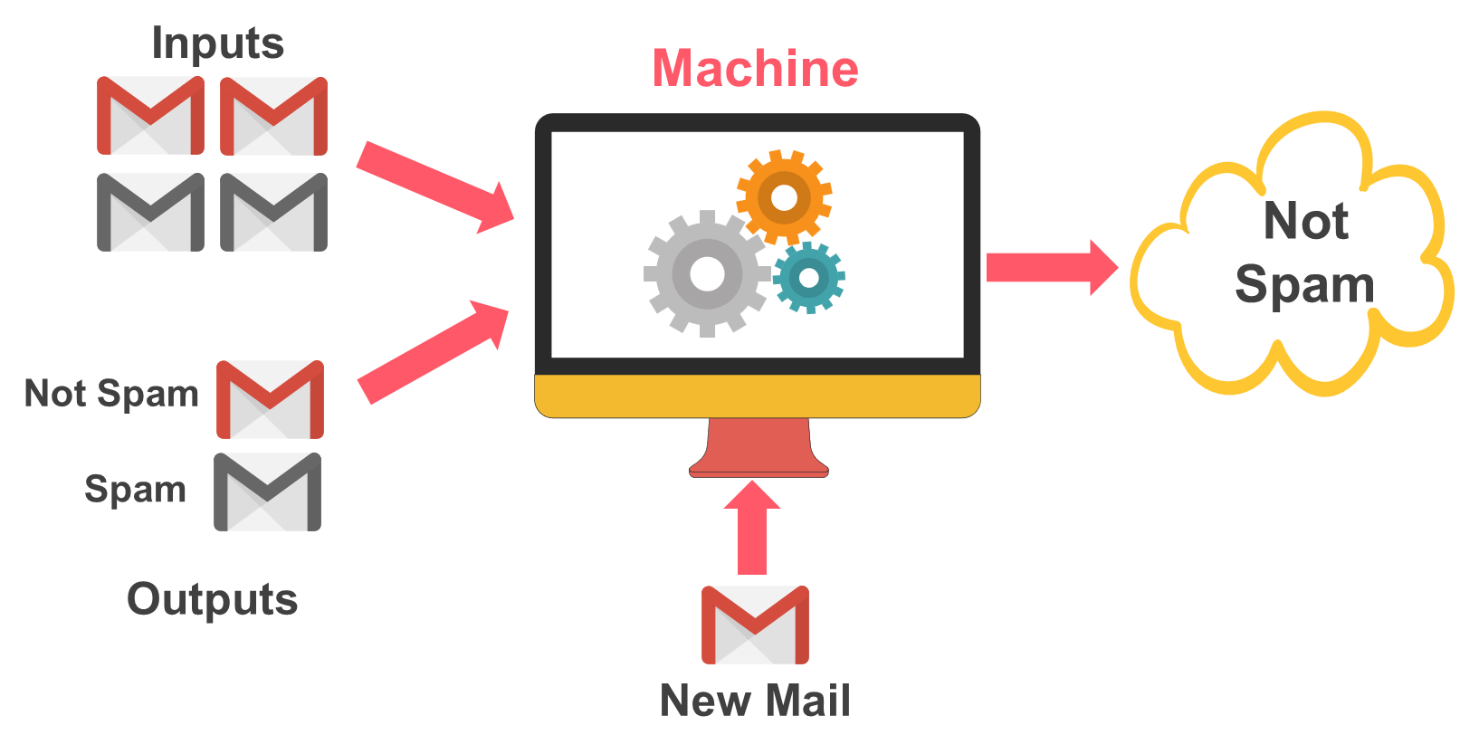
Supervised Learning – Example
Spam classification: 2 labels (Ham and Spam), a binary problem

Slide 30
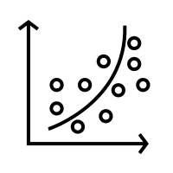
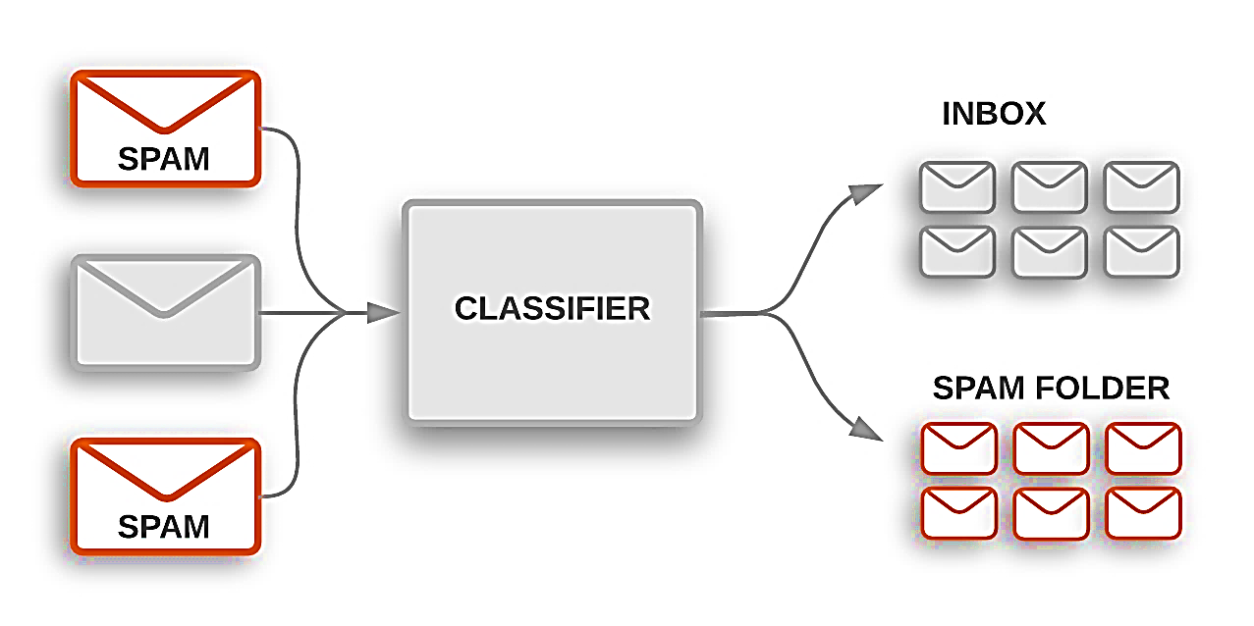
Types of Supervised Learning
Supervised Learning
Regression Problems
Classification Problems
Output variable: real or continuous numeric value
Output variable: categorical with two or more classes
Salary
Experience
Salary Prediction
Spam Filter

Slide 31
Types of Supervised Learning
Supervised Learning
Regression Problems
Classification Problems
Simple Linear Regression
Multiple Linear Regression
Polynomial Regression
Support Vector Regression (SVR)
Decision Tree Regression
Random Forest Regression
Logistic Regression
Support Vector Machines (SVM)
K-Nearest Neighbors (KNN)
Decision Tree Classifier
Random Forest Classifier
Naïve Bays Classifier

Slide 32
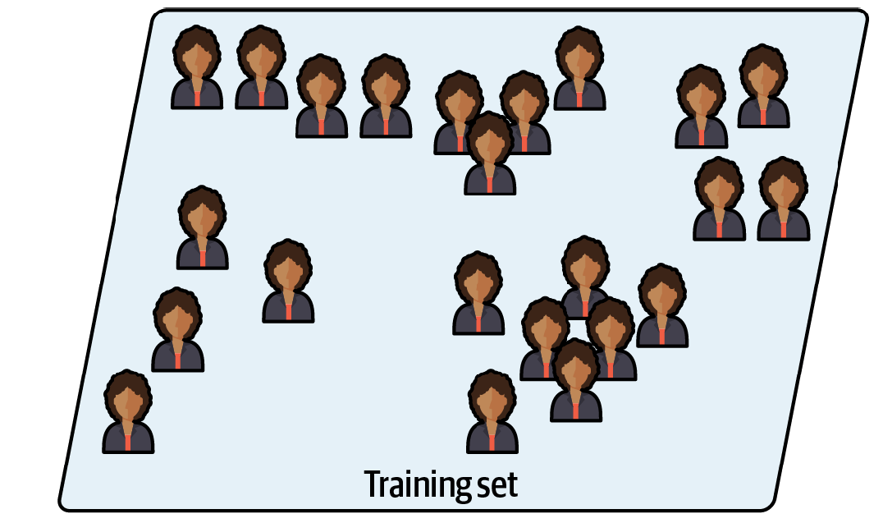

Unsupervised Learning
Training Data is Unlabeled (desired output is unknown).
For example, data about your blog’s visitors or visitors of a shopping mall.
Only input data is given.
No supervision is provided (learning without a teacher).
Find hidden patterns in the data.

Slide 33
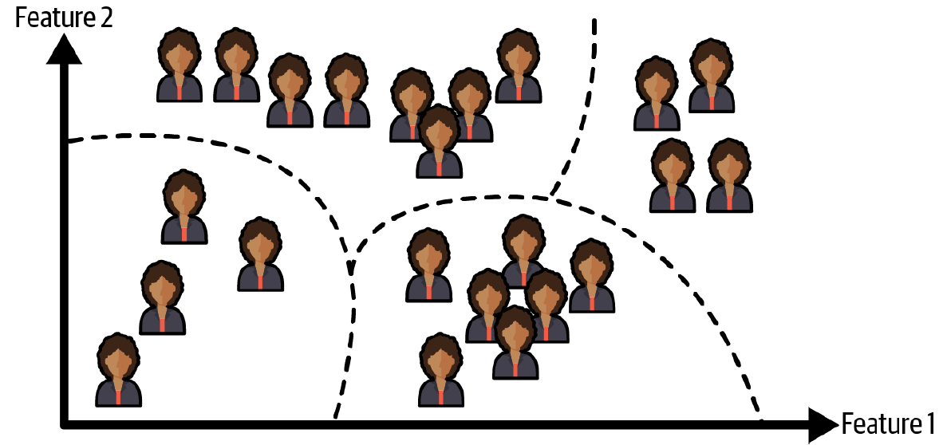
Unsupervised Learning – Example 1
Apply unsupervised algorithm to detect groups of similar visitors.
An unlabeled training data about your blog’s visitors.

Slide 34



Unsupervised Learning – Example 2
Call duration
Machine
C
Find hidden pattern
Internet usage
A
B
Call duration
Internet usage
Insights
Group A: Give them cheaper data plans.
Group B: Give them cheaper call rates.
Group C: Give them both benefits.
Input Data

Slide 35
Types of Unsupervised Learning
Unsupervised Learning
Clustering Problems
Anomaly
Detection
Association Problems
Visualization Algorithms

Slide 36
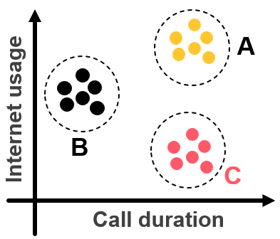
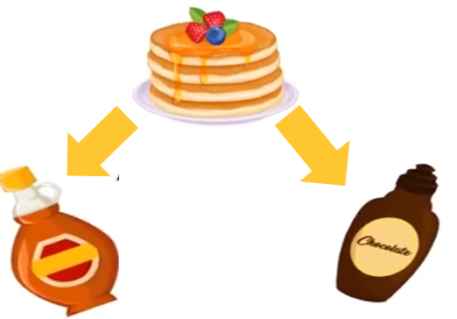
Types of Unsupervised Learning
Unsupervised Learning
Clustering Problems
Association Problems
Divide data points into different groups based on similar properties.
Link one variable with another variable
Customer segmentation with similar preferences.
If someone by a cake, he might be interested to by chocolate or maple syrup.

Slide 37
Types of Unsupervised Learning
Unsupervised Learning
Clustering Problems
Association Problems
K-Means Clustering
Hierarchical Clustering
DBSCAN
Apriori Algorithm
Eclat Algorithm

Slide 38
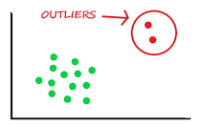
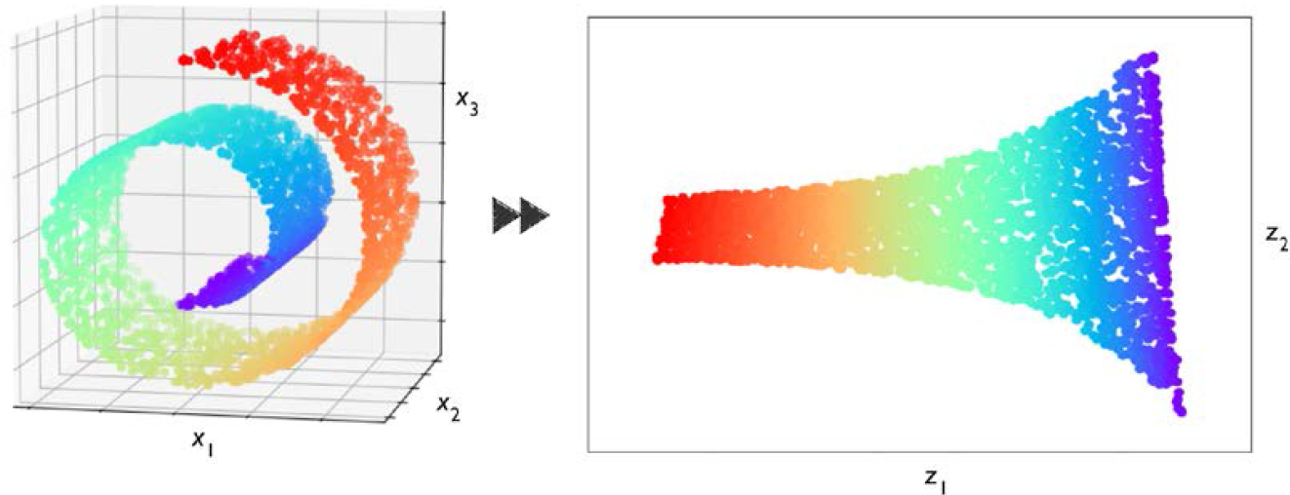
Types of Unsupervised Learning
Unsupervised Learning
Visualization Algorithms
Anomaly
Detection
Feed them a lot of complex and unlabeled data, and they output a 2D or 3D representation of your data that can easily be plotted
Finding unusual examples, e.g., credit card fraud, network intrusion.

Slide 39
Types of Unsupervised Learning
Unsupervised Learning
Visualization Algorithms
Anomaly
Detection
Principal Component Analysis (PCA)
Kernel PCA
Locally-Linear Embedding (LLE)
t-distributed Stochastic Neighbor Embedding (t-SNE)
One-class SVM
Isolation Forest

Slide 40
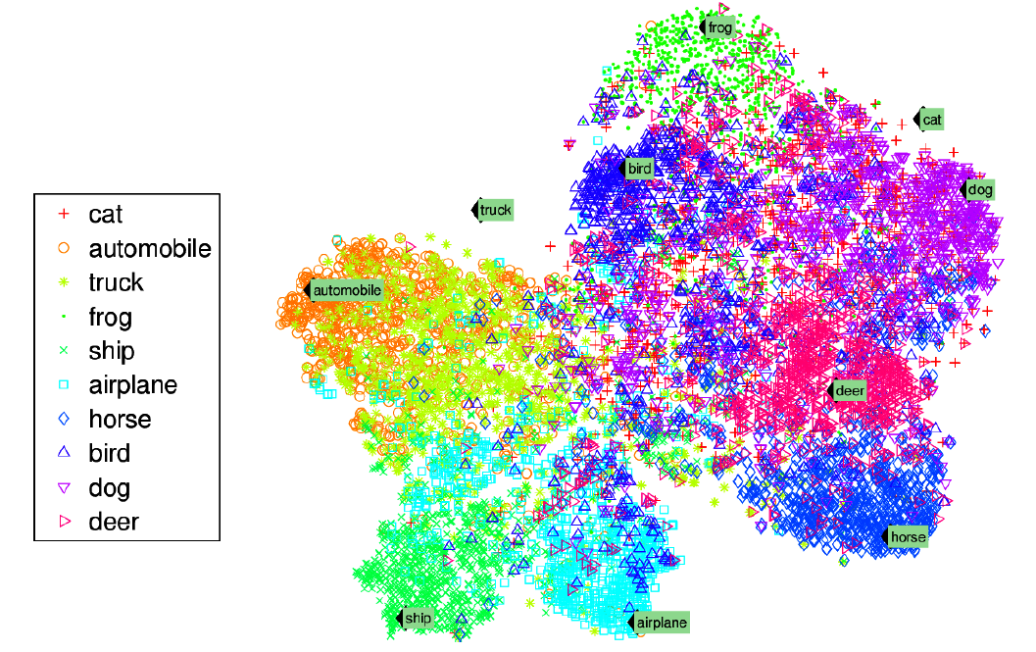
Visualization – Example
Using dimensionality reduction (here: t-SNE), 3072 dimensions reduces to only 2 dimensions.
Example of a t-SNE visualization highlighting semantic clusters*
*how animals are rather well separated from vehicles and how horses are close to deer but far from birds.

Slide 41
Why Reduce Dimensions?
Smaller dataset:
Needs less space
Learning is faster
Better accuracy, if ’bad’ predictors are removed.
How:
Remove (irrelevant, or redundant) features
http://tylervigen.com/spurious-correlations
Merge (correlated) features
age and mileage of a car => ‘wear and tear’
But if we remove too many, then accuracy will suffer.
Sweetspot, or ‘goldilocks zone’’

Slide 42
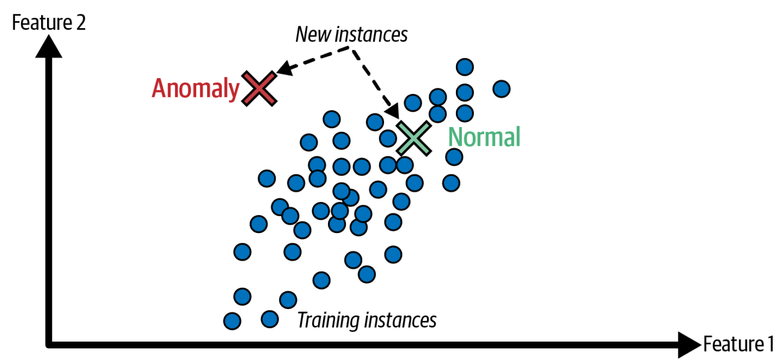
Anomalies Detection – Example
Detecting unusual credit card transactions to prevent fraud.
Detect new instances that look different from all instances in the training set.
Anomaly detection

Slide 43
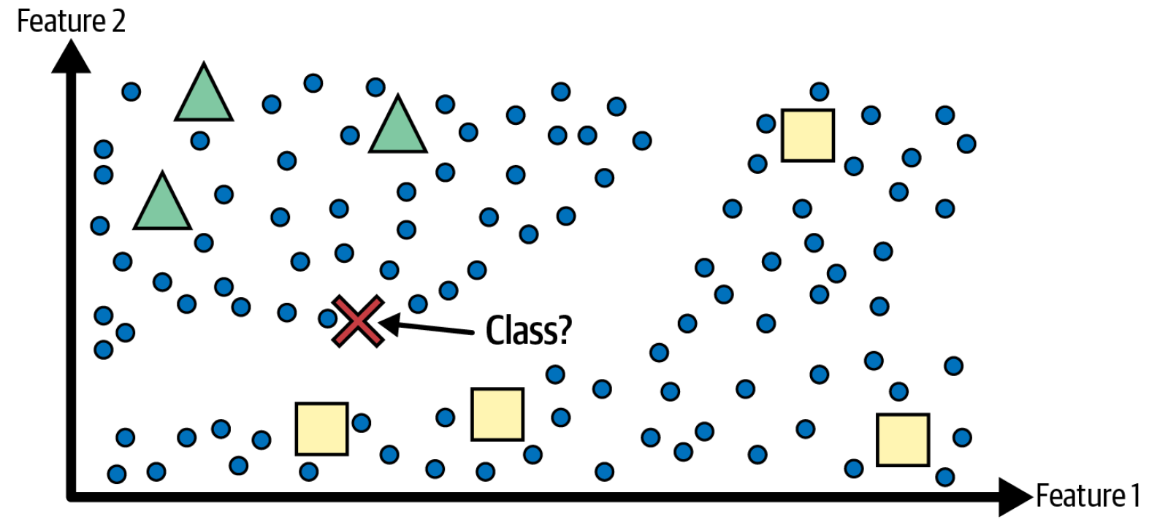
Semisupervised Learning
Uses a combination of supervised and unsupervised methods.
Train a classifier with many unlabeled, and a few labeled examples.
Very useful in practice, because labels are often time-consuming and costly.

Slide 44


Semisupervised Learning - Example
Person A
Google Photos use this.
You just name each person once.
They detect the same person in multiple photos.
Person B
Semi-supervised learning with two classes (Person A and Person B).
The unlabeled examples (circles) help classify a new instance (the cross) into the Person A class rather than the Person B class, even though it is closer to the labeled Person B.

Slide 45

Reinforcement learning
Different from Other Learning:
🚀 Learns by interacting with environment
Learning system is called agent:
🎯 Agent takes actions, receives rewards or penalties
Objective: Maximize Rewards
🔍 Finds best strategy (policy)
✅ Policy tells which action to take in each situation
Example: Riding a Bicycle

Slide 46
Reinforcement Learning – Example 1

Slide 47
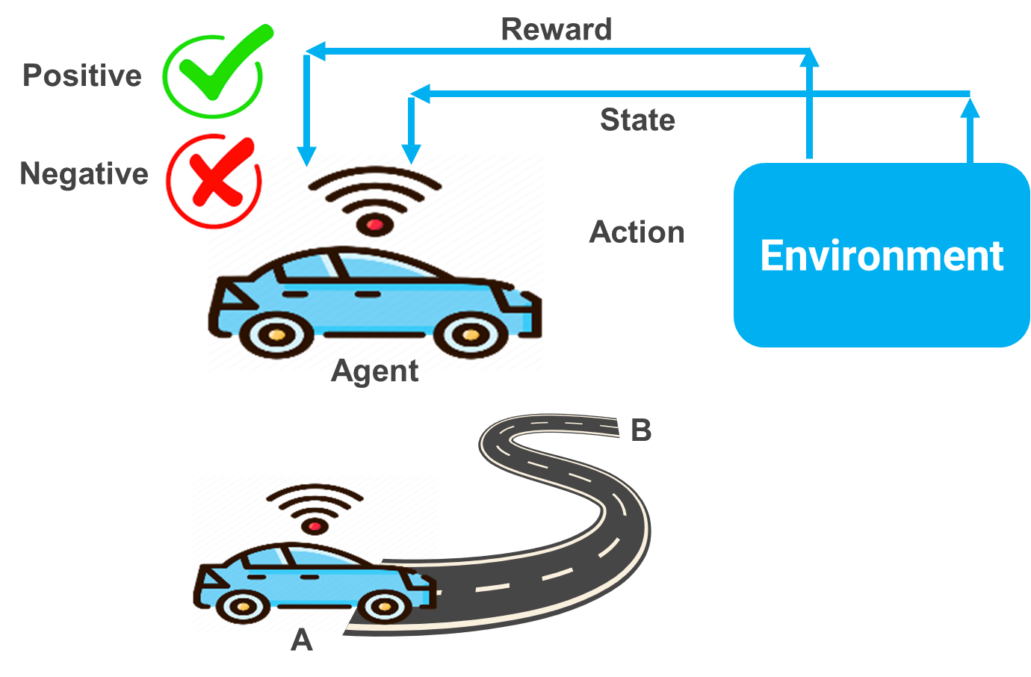
Reinforcement Learning – Example 2
Car (agent) senses road and surroundings (state).
Takes an action, like turning or stopping.
Gets feedback: reward (✔) or penalty (✖).
Learns best driving strategy (policy) over time.
Self-driving Cars

Slide 48
Batch Learning
Process:
Start with all (large) data
Train a model offline
Use model to make predictions
PROS:
Can build a strong, accurate model offline
CONS:
New data keeps coming
Must retrain with old + new data
Retraining can become too slow and costly (requires a lot of computing resources)

Slide 49
Online Learning
Process:
Learn step by step, as data arrives
Train with one or small batches of data
Model keeps learning even in production
PROS:
Adapts quickly to new data and patterns.
CONS:
Needs careful tuning to avoid forgetting old data.

Slide 50
Too Much Data?
If data does not fit into RAM, use online learning.

Slide 51
Instance-Based Learning
Learns by remembering all training examples.
Compares new data to stored examples
Generalizes by finding closest matches among stored examples.
Example: classify shape based on most similar shapes seen before.
New instance is classified as a triangle because most similar instances belong triangles

Slide 52
Model-Based Learning
Build a model from training examples.
Use the model to make predictions, e.g., a line that separates two classes, often called a decision boundary.

Slide 53
Model Based Learning Example

Slide 54
4 Steps of ML
STEP 1
STEP 4
Apply and Evaluate Model
Problem and Data
Deploy the model to new data and
check its performance.
Identify the problem and gather relevant data.
STEP 2
STEP 3
Train Model
Select Model and Algorithm
Train the model,
optimizing hyperparameter
values
Choose the appropriate model and algorithm.

Slide 55
Step 1: Problem and Data
2. Obtain GDP Data
1. Analyze OECD Data
Get GDP per capita
from World Bank
statistics.
3. Join Datasets
Download Better Life
Index data from
OECD website.
Join both datasets
and sort by
GDP per capita.
Question: Does money make people happier?

Slide 56
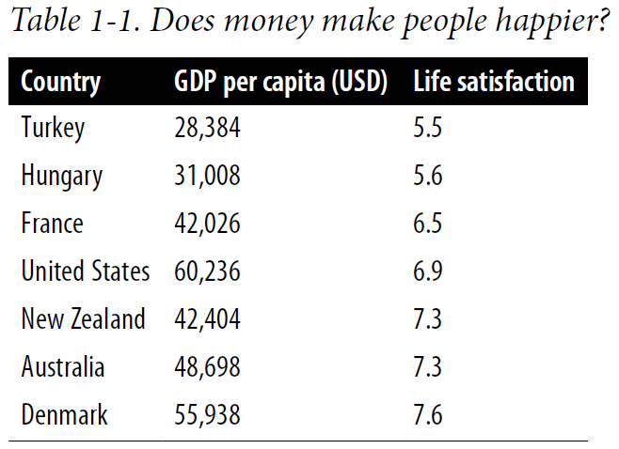
Step 1: Problem and Data
Table shows sample data to analyze happiness vs. money

Slide 57
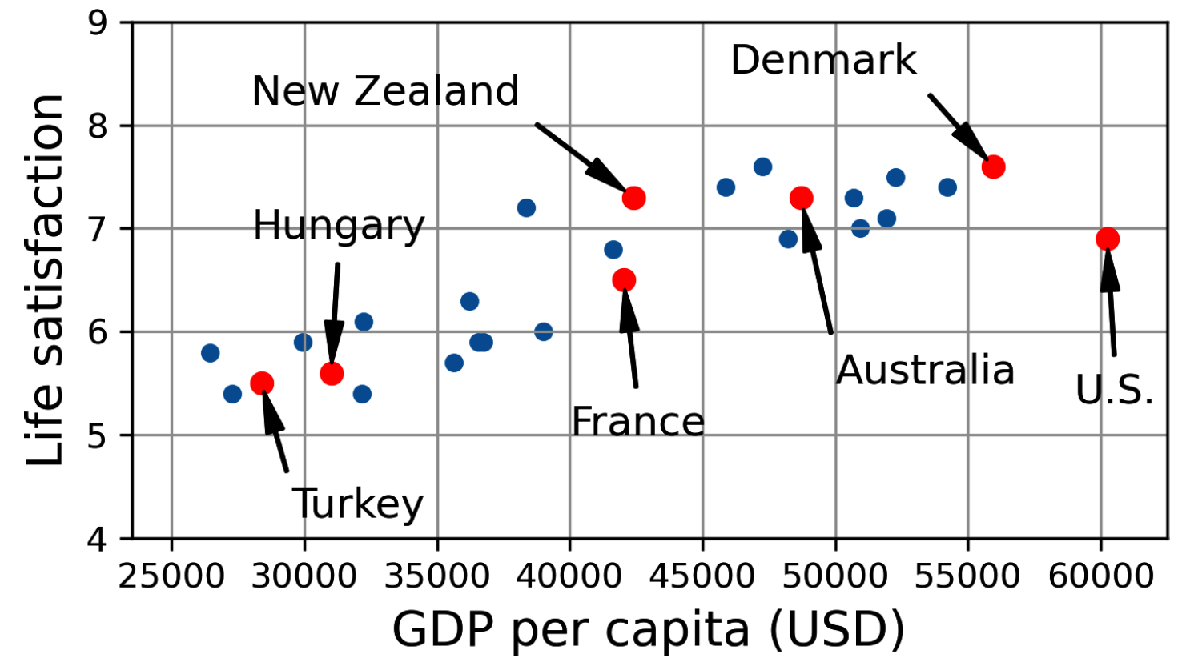
Step 1: Problem and Data
Plot the data for countries in Table 1-1.
Do you see a trend here?

Slide 58
Step 2: Select a Model
Data shows a positive trend:
Higher GDP per capita → Higher life satisfaction
Life satisfaction appears to increase linearly with GDP per capita
This motivates a linear model:
Life satisfaction = f(GDP per capita)

Slide 59
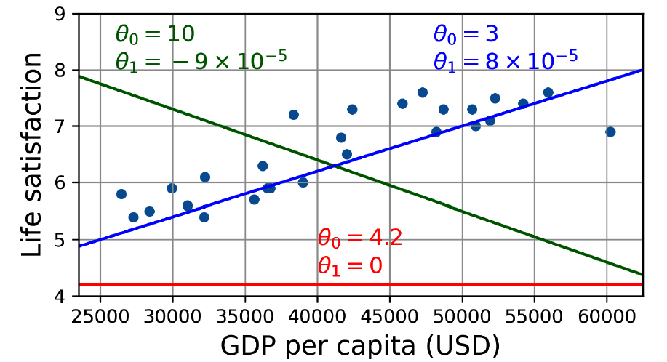
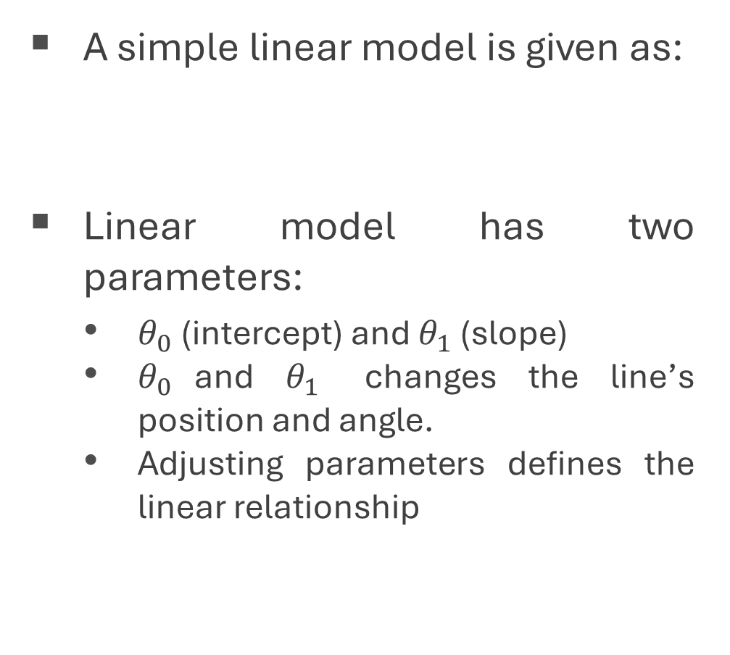
Step 2: Select a Model
A simple linear model is given as:
Linear model has two parameters:
$θ_{0}$(intercept) and $θ_{1}$ (slope)
$θ_{0}$and $θ_{1}$ changes the line’s position and angle.
Adjusting parameters defines the linear relationship
A few possible linear models

Slide 60
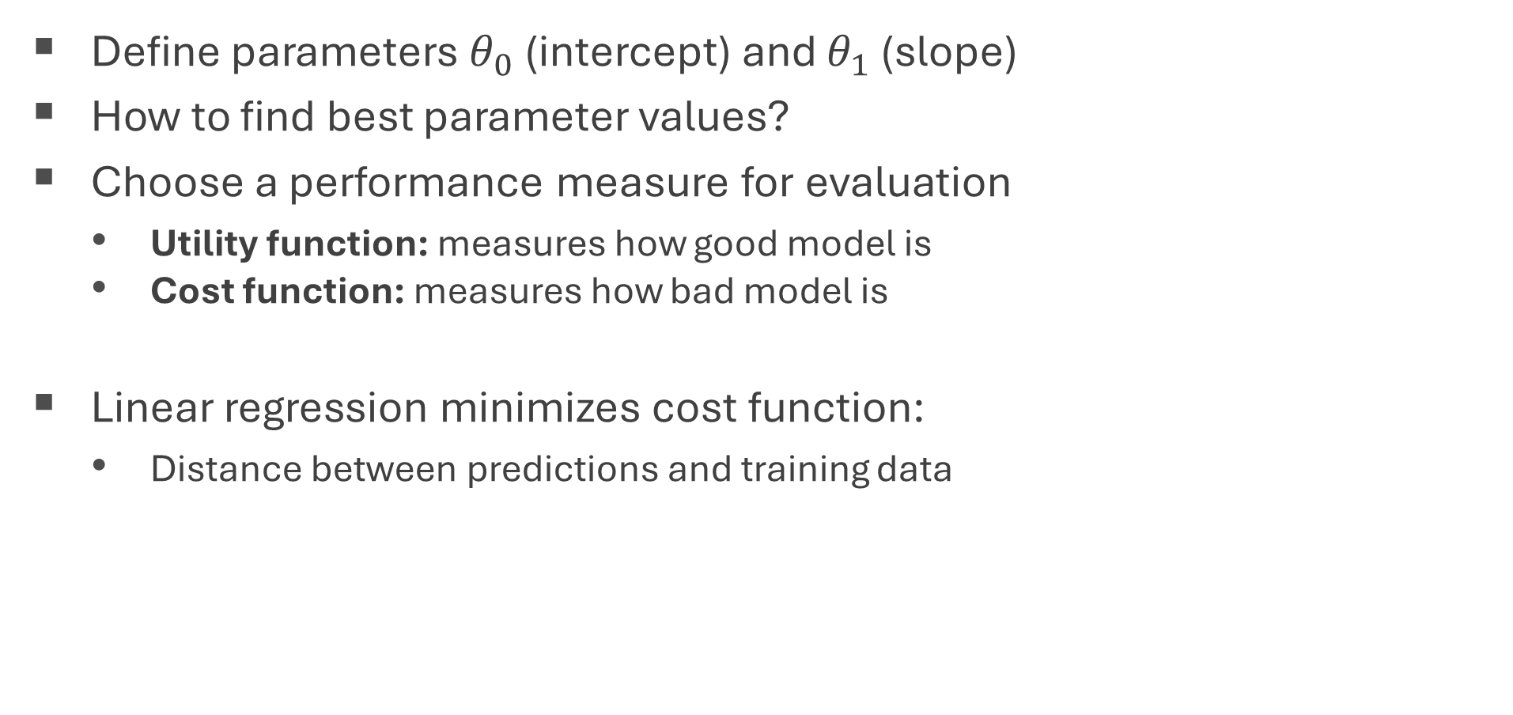
Step 3: Training the Linear Model
Define parameters $θ_{0}$(intercept) and $θ_{1}$ (slope)
How to find best parameter values?
Choose a performance measure for evaluation
Utility function: measures how good model is
Cost function: measures how bad model is
Linear regression minimizes cost function:
Distance between predictions and training data

Slide 61
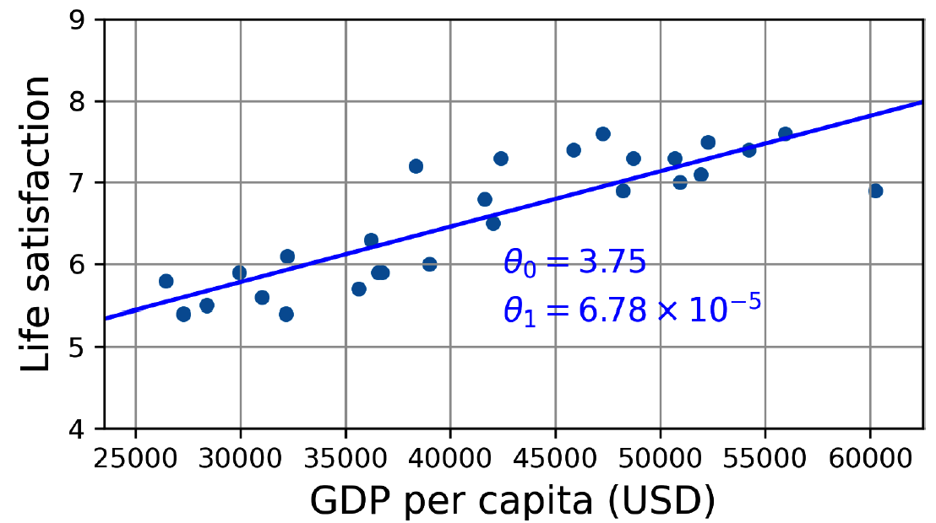
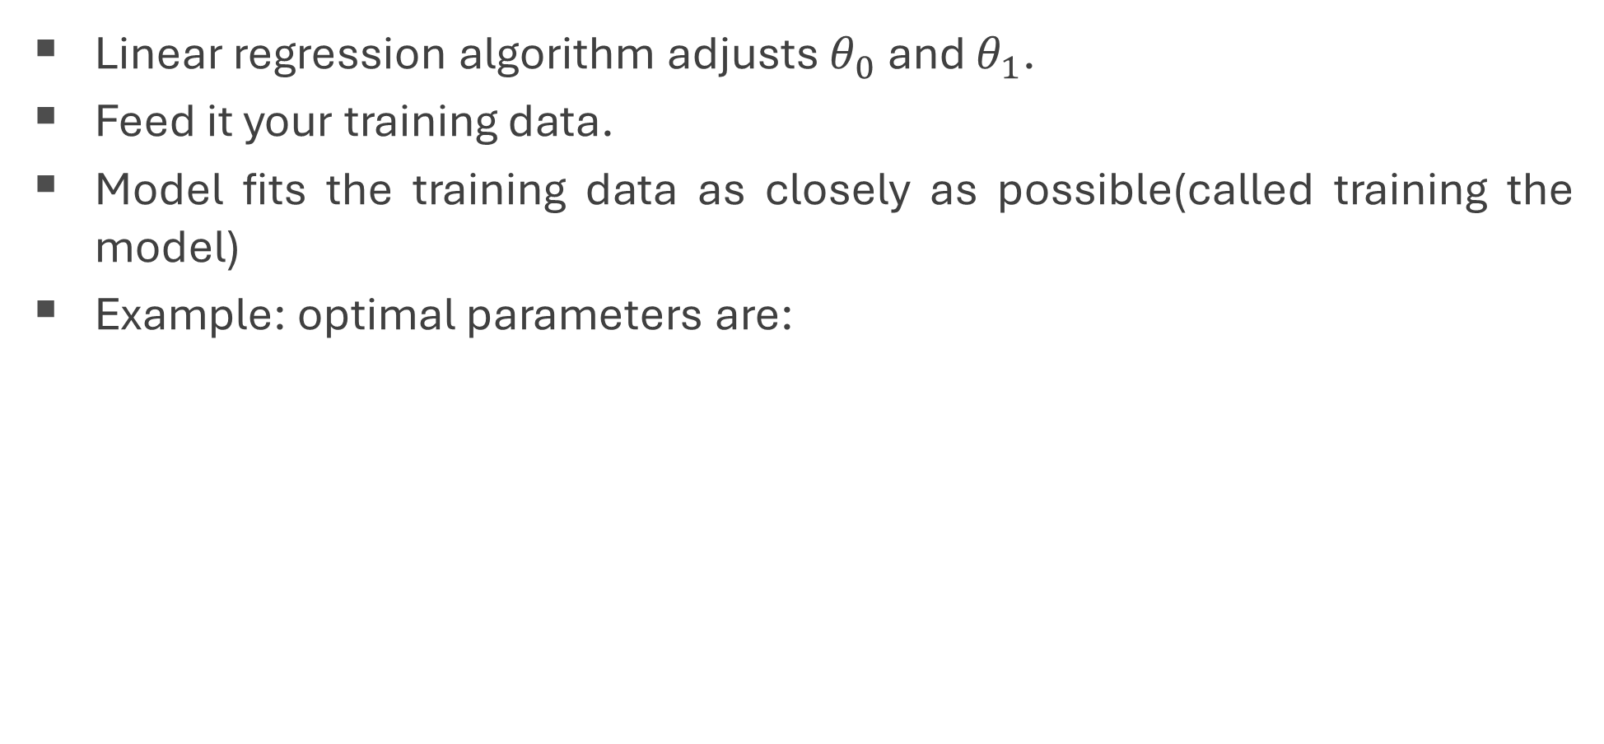
Step 3: Training the Linear Model
Linear regression algorithm adjusts $θ_{0}$and $θ_{1}$.
Feed it your training data.
Model fits the training data as closely as possible(called training the model)
Example: optimal parameters are:
The linear model that fits the training data best

Slide 62
Step 4: Apply Model to New Data
Model can now be used for predictions
Example: predict happiness of Cypriots
Use Cyprus GDP: $37,655 in the model
The linear model that fits the training data best

Slide 63
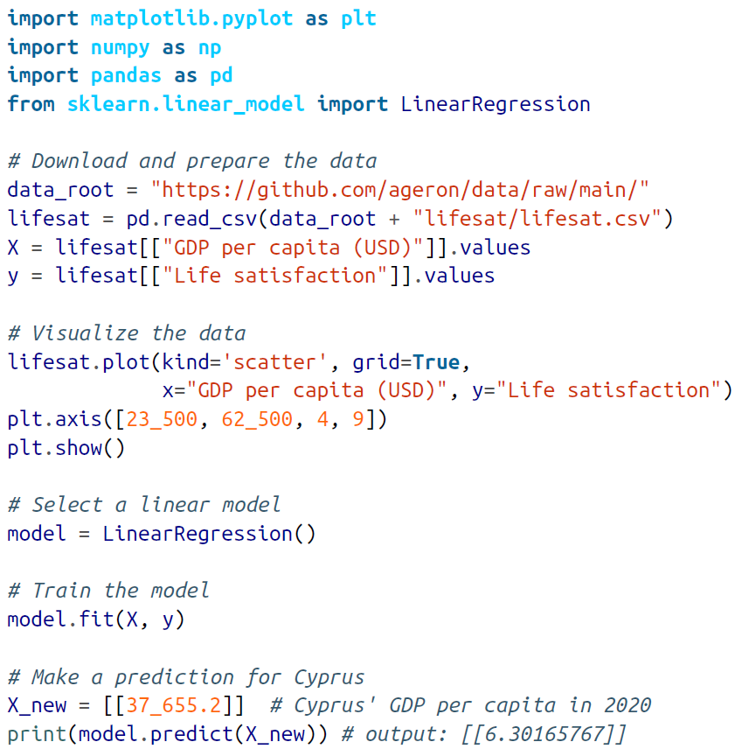
Training and running a linear model
Using Scikit-Learn
Python code loads data and labels, creates scatterplot, trains model, makes prediction.

Slide 64
Testing and Validating
How do we know a model is any good?
Split Data into two parts:
Training set (80%)
Test set (20%)
Train model on train, validate on test
But: say you train 100 models, select the best (5% test error), but on new data it has 15% error. Not good?

Slide 65
Testing and Validating
Better split into three parts:
Training (60%)
Validation (20%)
Test (20%)
Use validation error to select best model, then use test set to judge real error
Even better:
Split into train + test
Use cross-validation (will explain later) on train data

Slide 66
Main Challenges of Machine Learning

Slide 67
Main Challenges of Machine Learning
Main task: select model and train on data.
Two common issues:
Bad model — poor algorithm choice
Bad data — poor quality or quantity of data
We start with examples of bad data.

Slide 68
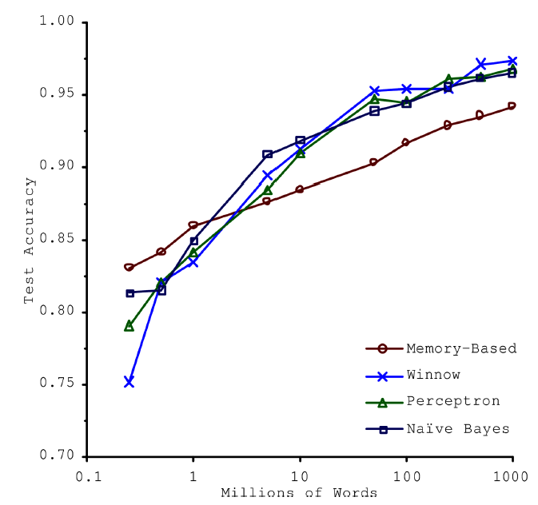
Insufficient Quantity of Training Data
Human example:
Toddlers learn with few examples — ML does not
Why?
ML cannot infer well from few examples
Needs lots of data to work properly
Simple problems need thousands of examples
Complex tasks (image, speech) need millions

Slide 69
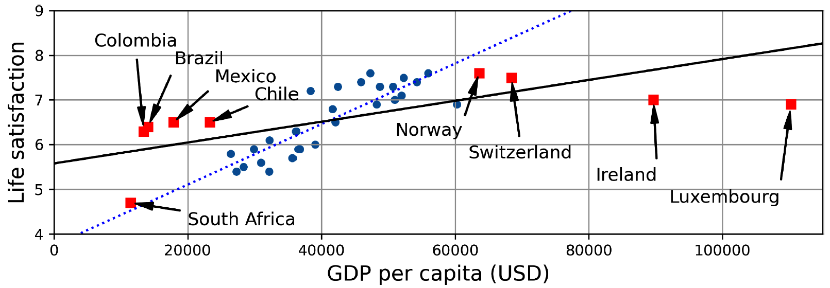
Nonrepresentative Training Data
Importance:
Training data must represent the target cases.
Too small samples lead to sampling noise.
Poor sampling method causes sampling bias.
Example:
Earlier model missed very poor and very rich countries
New data changes the model significantly.

Slide 70
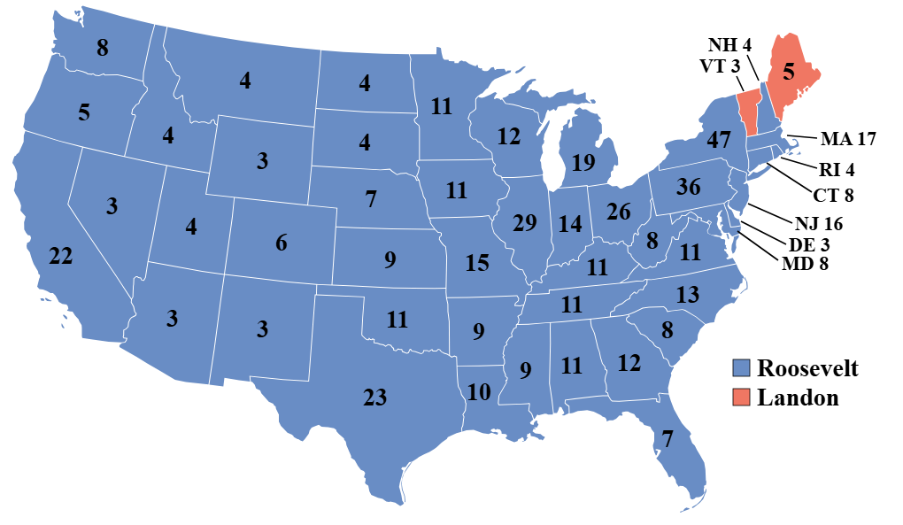
Nonrepresentative Training Data
Impact:
Risk of misleading conclusions.
Example of Sampling Bias:
1936 US election: wrong prediction
Mailed 10M surveys, only 2.4M replied
Predicted Landon (57%), but Roosevelt won (62%).
Reasons for Bias:
10M included more wealthy voters (conservative)
Less than 25% response — nonresponse bias

Slide 71
Poor-Quality Data
Raw data often has errors, outliers & noise
Step 1: Clean Data
Essential but time-consuming
Step 2: Deal with Outliers
Remove unusual values or✍️ Correct manually if possible
Step 3: Handle Missing Values
Remove instance: Delete incomplete records
Ignore feature: Drop problematic column
Impute values: Replace with median/mean
Compare: Train models with & without feature

Slide 72
Poor-Quality Data
Irrelevant features: GIGO garbage-in-garbage-out:
Feature engineering improves data quality:
Selection
Extraction
Gathering additional data

Slide 73
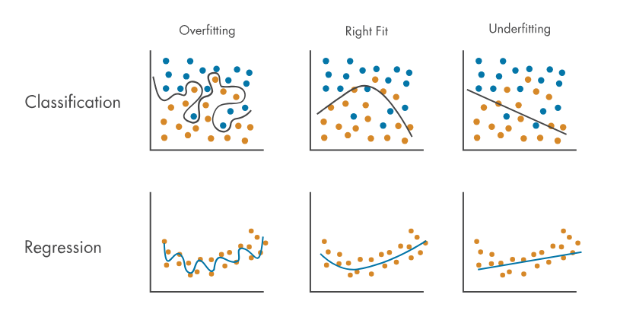
Which Model Fits the Data Right?
Overfitting
Right Fit
Underfitting
1
2
3
Overfitting
Right Fit
Underfitting
1
2
3

Slide 74
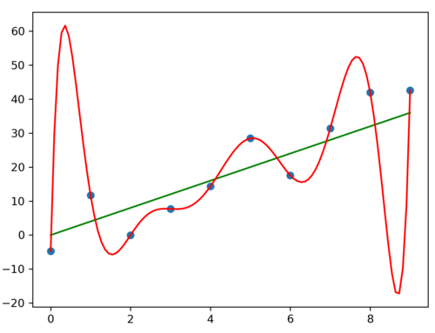
Overfitting the Training Data
Overfitting: model performs well on training data but fails to generalize (fails on new data).
Causes:
Noisy or small training data
Complex model on small data
Irrelevant features create false patterns
Overfitting

Slide 75
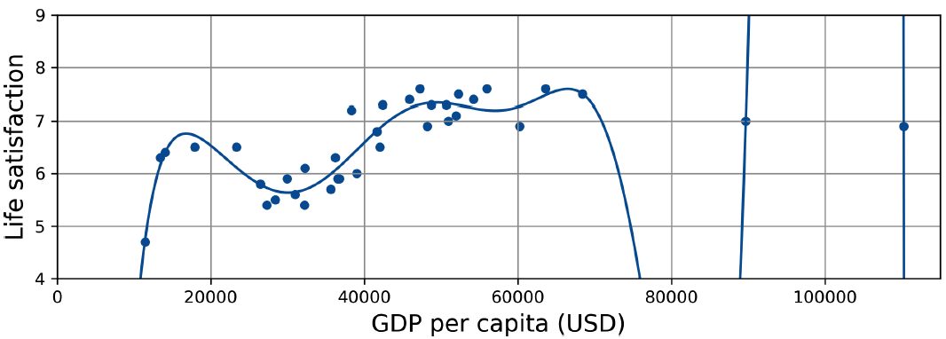
Overfitting the Training Data
Example:
New Zealand, Norway, Sweden, Switzerland: Life satisfaction > 7
Model finds pattern: ‘w’ means happy countries (Bad rule)
How about Rwanda, Zimbabwe?
Overfitting the training data

Slide 76
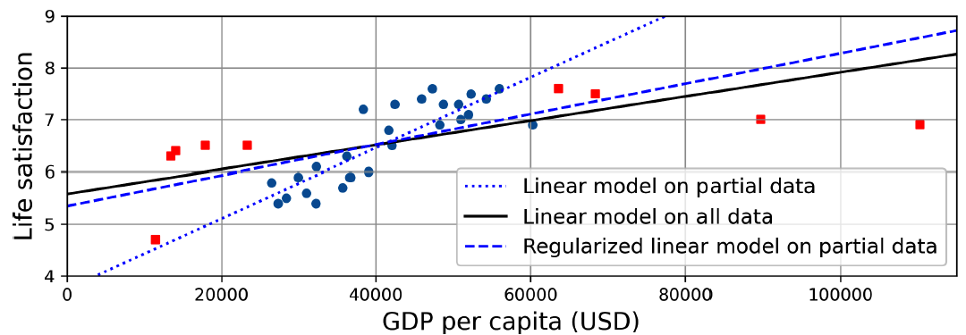
Solution to Overfitting
Collect more data
Reduce noise (fix errors, remove outliers)
Simplify the model: fewer parameters, fewer attributes, constrain the model
Limiting the model to make it simpler is called Regularization
Regularization reduces the risk of overfitting

Slide 77
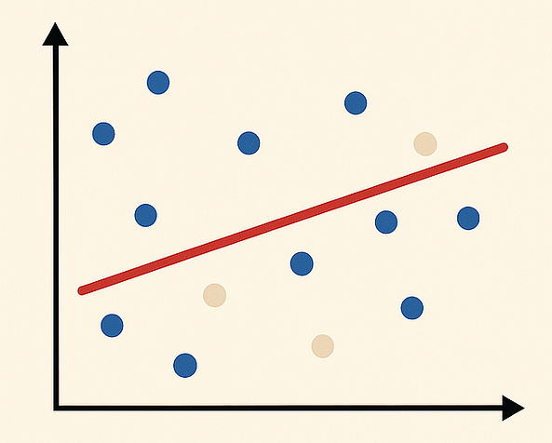
Underfitting the Training Data
Underfitting: Opposite to overfitting. Model performance is bad on both training and testing (new unseen) data.
Causes:
Model is too simple to learn data patterns
Solution:
Select more powerful model (more parameters)
Feed better features (Feature Engineering)
Remove the constraints
Underfitting

Slide 78
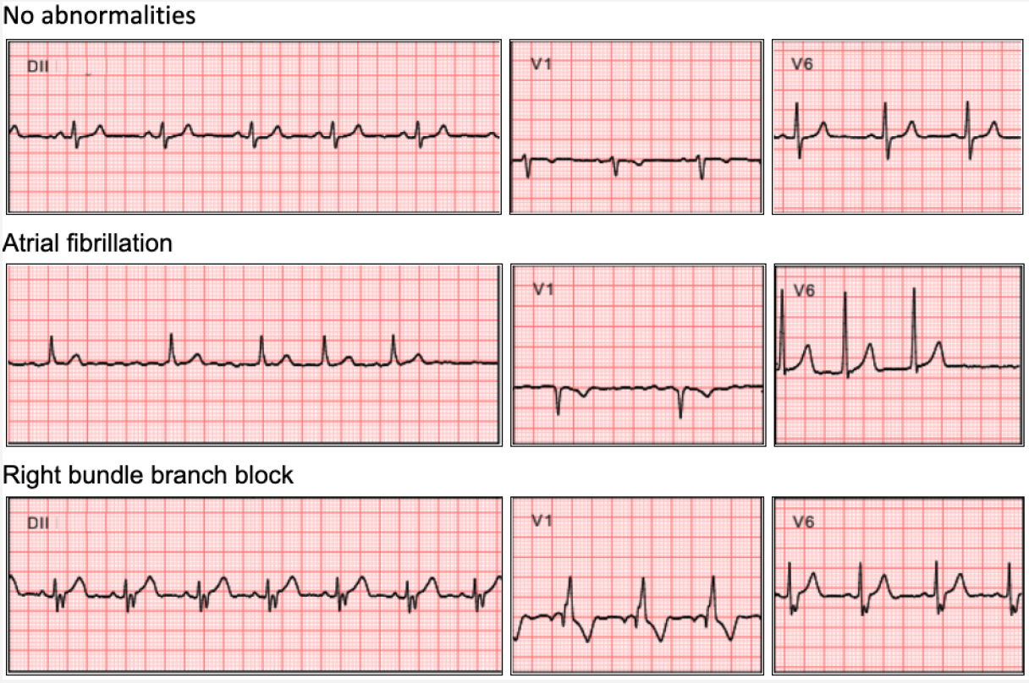
Example: ECG Prediction
Examples of (parts of) the measured ECG signals from three different hearts.

Slide 79
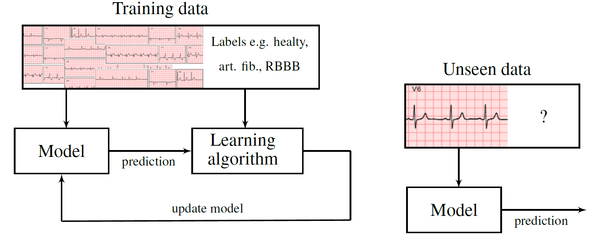
Example: ECG Prediction
Illustrating the supervised machine learning process with training to the left and then the use of the trained model to the right.

Slide 80
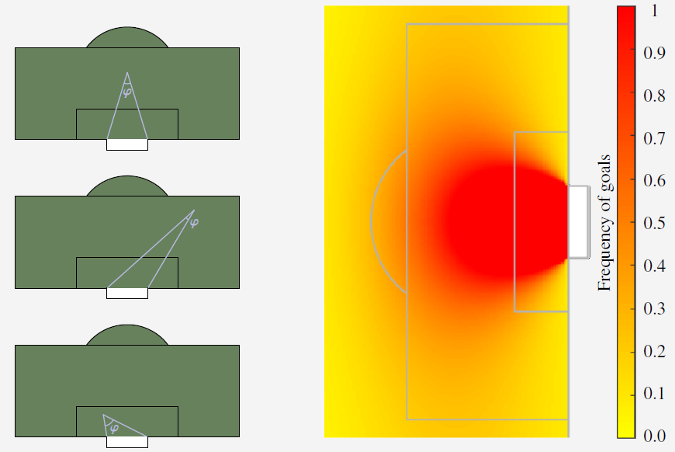
Example: Soccer Goal Scoring Probability
Using ML (logistic regression) we can obtain a predicted probability of scoring a goal from any position, illustrated using a heat map.

Slide 81
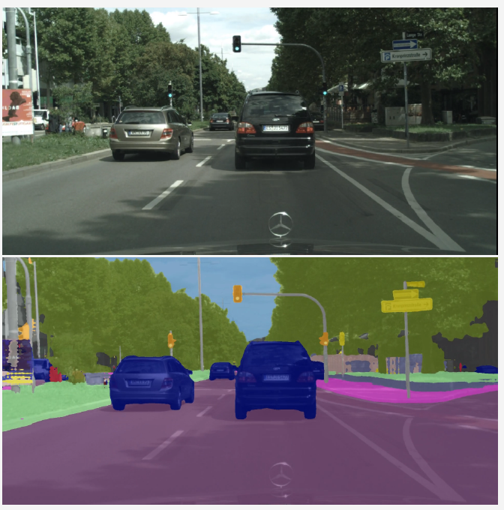
Example: Pixel-wise class prediction
Predictions (bottom part) generated by semantic segmentation model.
Classify each pixel as either car (blue), traffic sign (yellow), pavement (purple), or tree (green).

